Slide 1


CARLA
Eric
Sree
Linbo

Slide 2
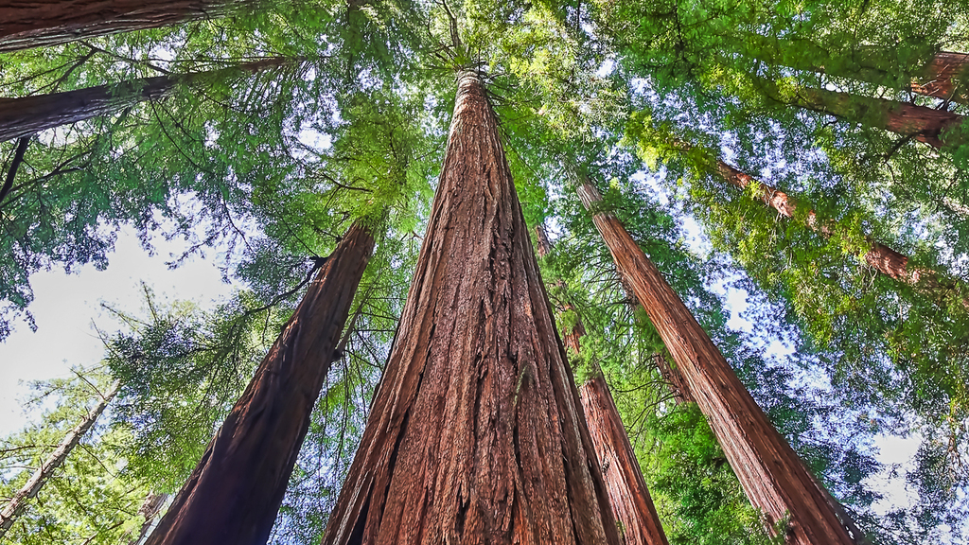
Model Used
RESNET 50 & DETR

Slide 3
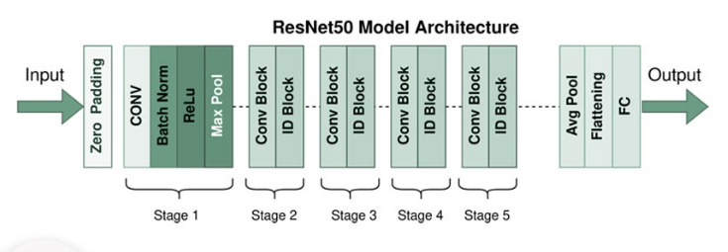
What is RESNET50?
Notes:
So what is resnet50? It is an artificial neural network that introduced a “identity shortcut connection,” which allows the model to skip one or more layers. This approach makes it possible to train the network on several layers without affecting performance. ResNet-50 is a convolutional neural network that is 50 layers deep.

Slide 4
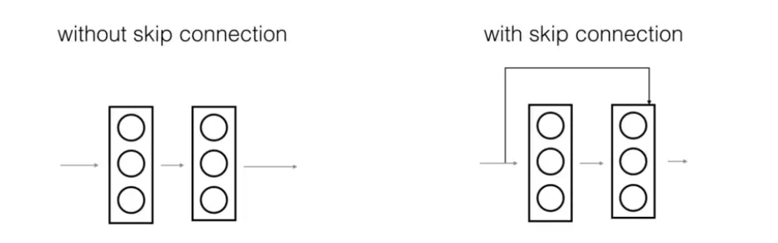
Why did we use RESNET50?
Notes:
RESNETs address the issue of vanishing gradients. Prior to ResNet, training very deep neural networks was difficult due to the problem of vanishing gradients. RESNETs are well suited for image processing therefore we applied it to scenes in Carla.
The image on the left is stacking convolution layers together one after the other without a skip connection. Image on the right shows skip connection it still stacks convolution layers one after the other as before, but we now also add the original input to the output of the convolution block. This is called skip connection
Skip connections address the issue of vanishing gradient by allowing an alternate shortcut path for gradient to flow through
They allow the model to learn an identity function which ensures that the higher layer will perform at least as good as the lower layer, and not worse

Slide 5

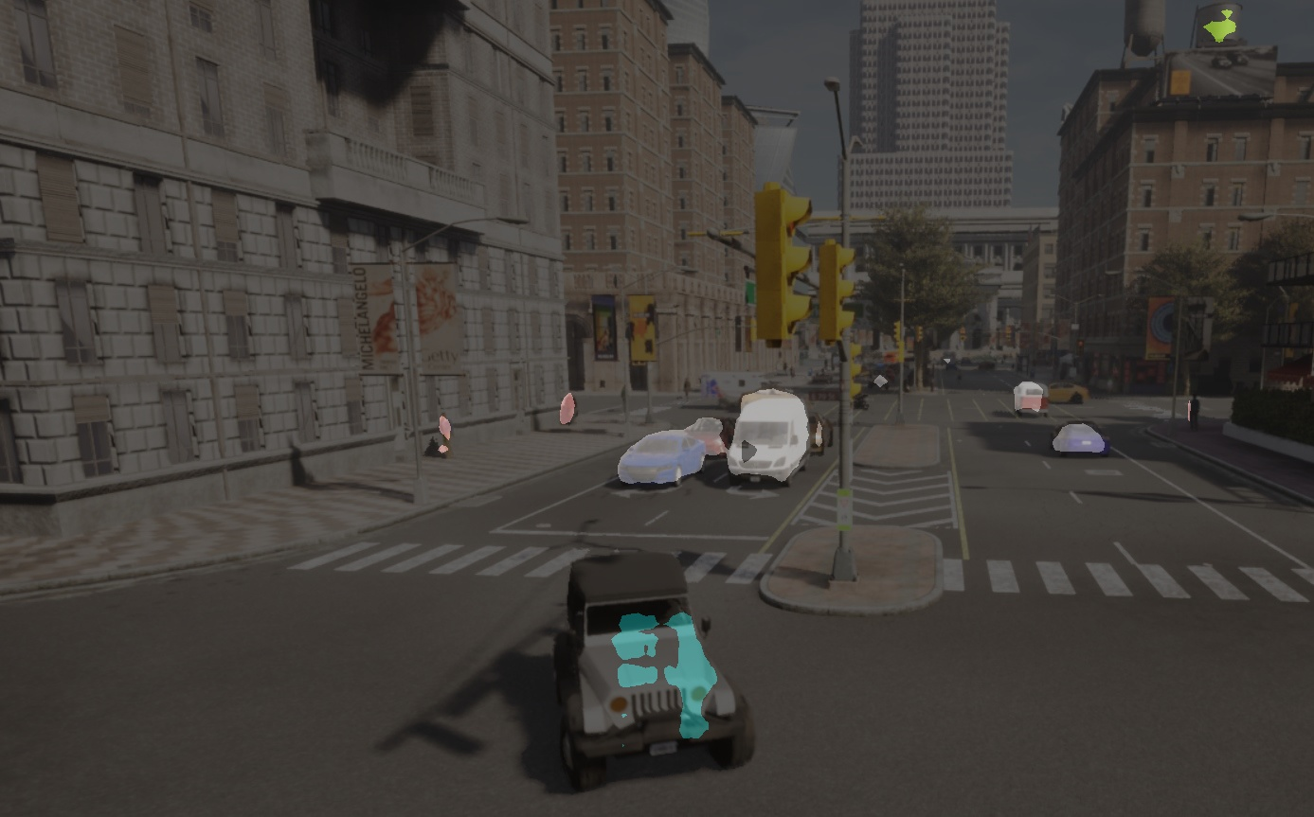


ReSNET Performance

Slide 6
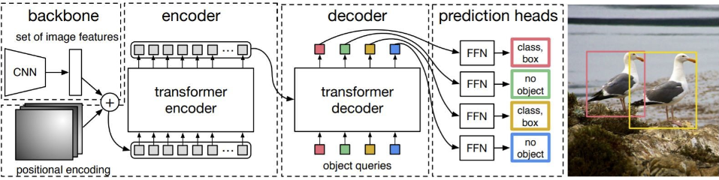
DETR
Implementation
Output image
Console output

Slide 7
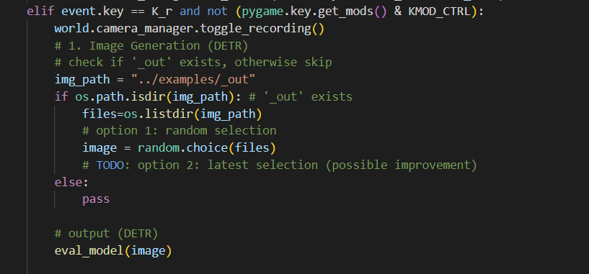
Image Generation Code
Notes:
So what is resnet50? It is an artificial neural network that introduced a “identity shortcut connection,” which allows the model to skip one or more layers. This approach makes it possible to train the network on several layers without affecting performance. ResNet-50 is a convolutional neural network that is 50 layers deep.

Slide 8
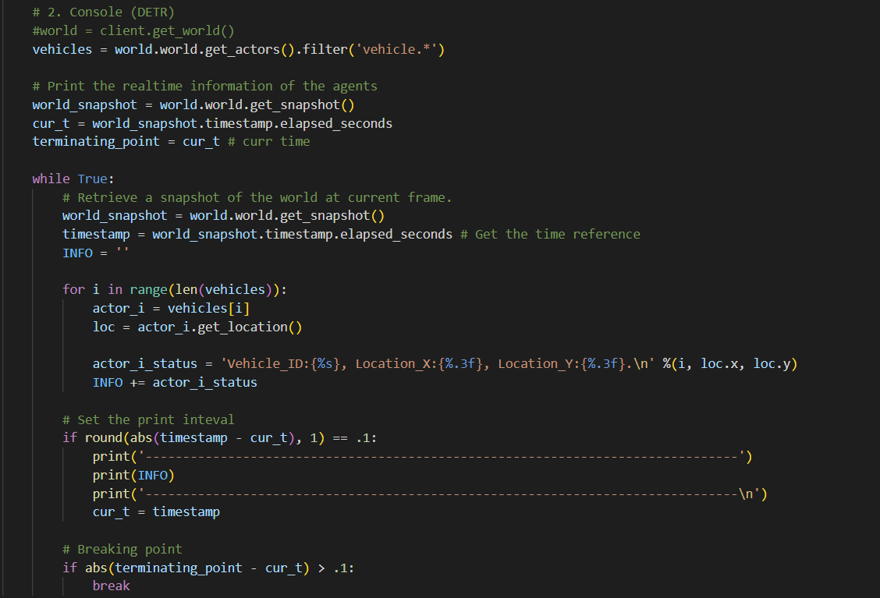
Console Output Code
Notes:
So what is resnet50? It is an artificial neural network that introduced a “identity shortcut connection,” which allows the model to skip one or more layers. This approach makes it possible to train the network on several layers without affecting performance. ResNet-50 is a convolutional neural network that is 50 layers deep.

Slide 9
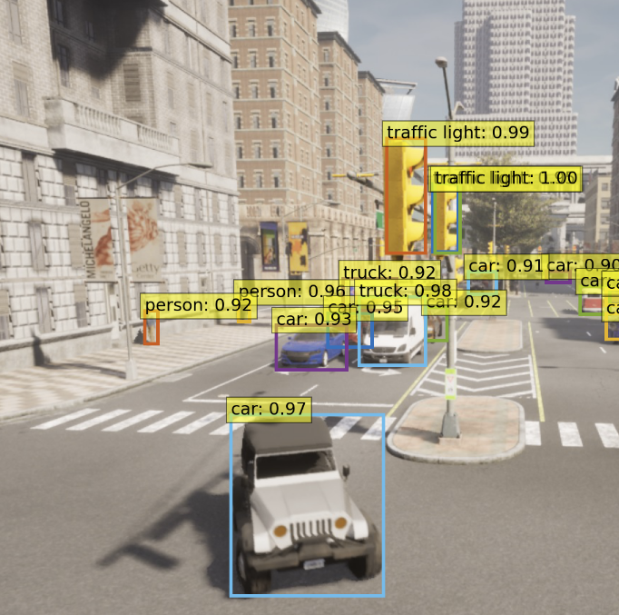
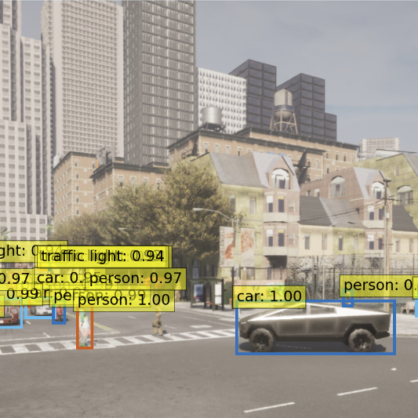
DETR Performance Image

Slide 10
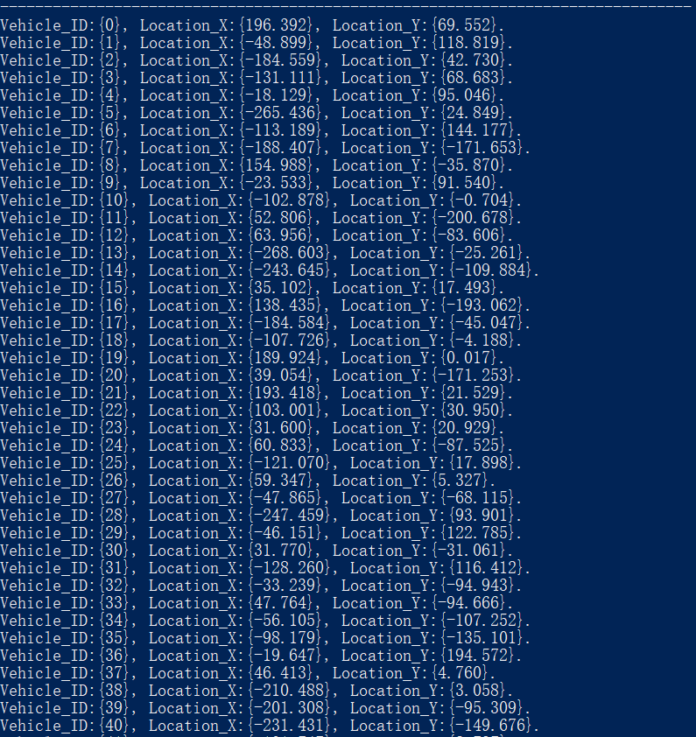
DETR Performance Console

Slide 11
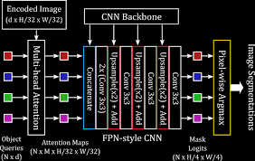
IMPROVEMENTS
DETR
Image
- UI
- Image selection mechanisms
- …
Console
- Only Objects in the camera vision
- Different spectators
- …

Slide 12
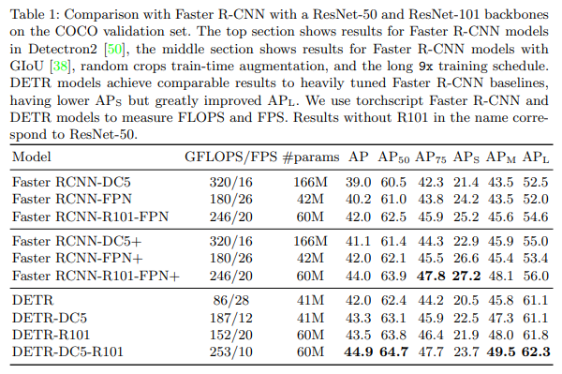
Comparing Accuracy

Slide 13
THAnk YOU

